Slide 1
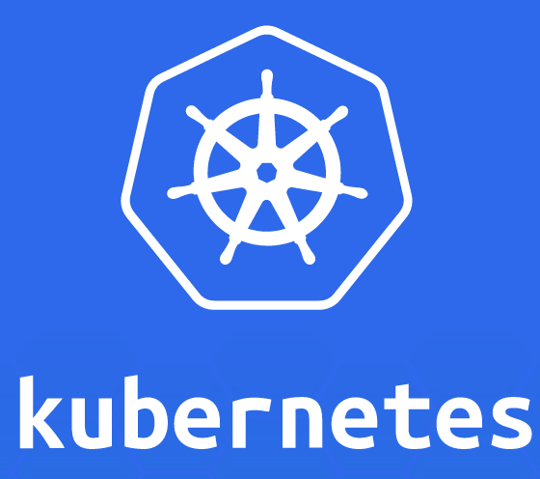
Kubernetes for Java Developers
Arun Gupta, @arungupta
Docker Captain, Java Champion

Slide 2
Docker Captain
Java Champion
JavaOne Rock Star (4 years)
NetBeans Dream Team
Silicon Valley JUG Leader
Author
Runner
Lifelong learner

Slide 3
Kubernetes
Open source orchestration system for containers
Docker, rkt, OCI, …
Started by Google, donated to CNCF
Provide declarative primitives for the “desired state”
Self-healing
Horizontal scaling
Automatic binpacking
Service discovery and load balancing

Slide 4
Kubernetes Concepts
Pods: colocated group of containers that share an IP, namespace, storage volume
Replica Set: manages the lifecycle of pods and ensures specified number are running (next gen Replication Controller)
Service: Single, stable name for a set of pods, also acts as LB
Label: used to organize and select group of objects
Node
Docker
Pod
“web”
Containers
port 8080
port 8080

Slide 5
Kubernetes Components
Master
Node: Machine or VM in the cluster
Master: Central control plane, provides unified view of the cluster
etcd: distributed key-value store used to persist Kubernetes system state
Worker: Docker host running kubelet (node agent) and proxy services
Runs pods and containers
Monitored by systemd (CentOS) or monit (Debian)
API Server
(pods, services, …)
Scheduler
Controller Manager
etcd
etcd
etcd
Worker
Kubelet
Proxy
Docker

Slide 6

Kubernetes Cluster
Internet
kubectl
Worker
Kubelet
Proxy
Load Balancer
Docker
Master
API Server
(pods, services, …)
Worker
Scheduler
Controller Manager
Kubelet
Proxy
etcd
etcd
etcd
Docker
Pod
Containers

Slide 7


Slide 8
Master High Availability
Hack by running a podmaster utility
Proposal
Hot Standby
Warm Standby
Active-Active (Load Balanced)
http://kubernetes.io/v1.1/docs/proposals/high-availability.html

Slide 9
kubectl
Controls the Kubernetes cluster manager
CRUD Kubernetes resources
create, get, describe, delete, …
kubectl create -f <filename>
kubectl get nodes or pods
kubectl scale —replicas=3 rc/<name>

Slide 10
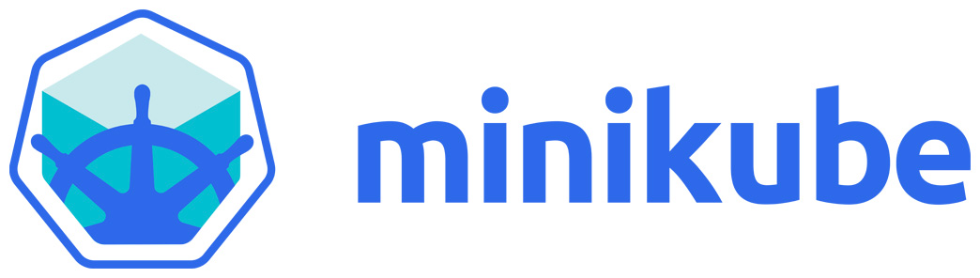
Minikube
Runs a single node cluster in a VM
Targeted for local development
minikube start, stop, docker-env, …
Requires kubectl CLI
github.com/kubernetes/minikube/releases

Slide 11

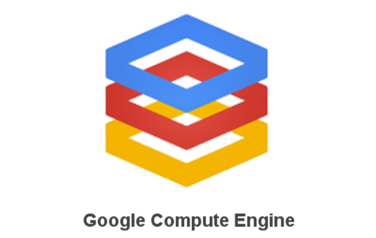

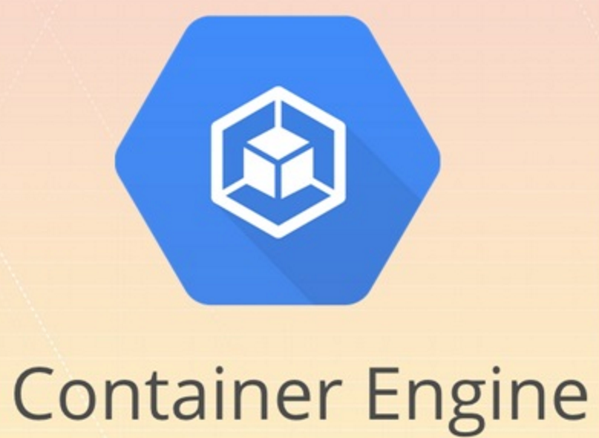



https://get.k8s.io/

Slide 12
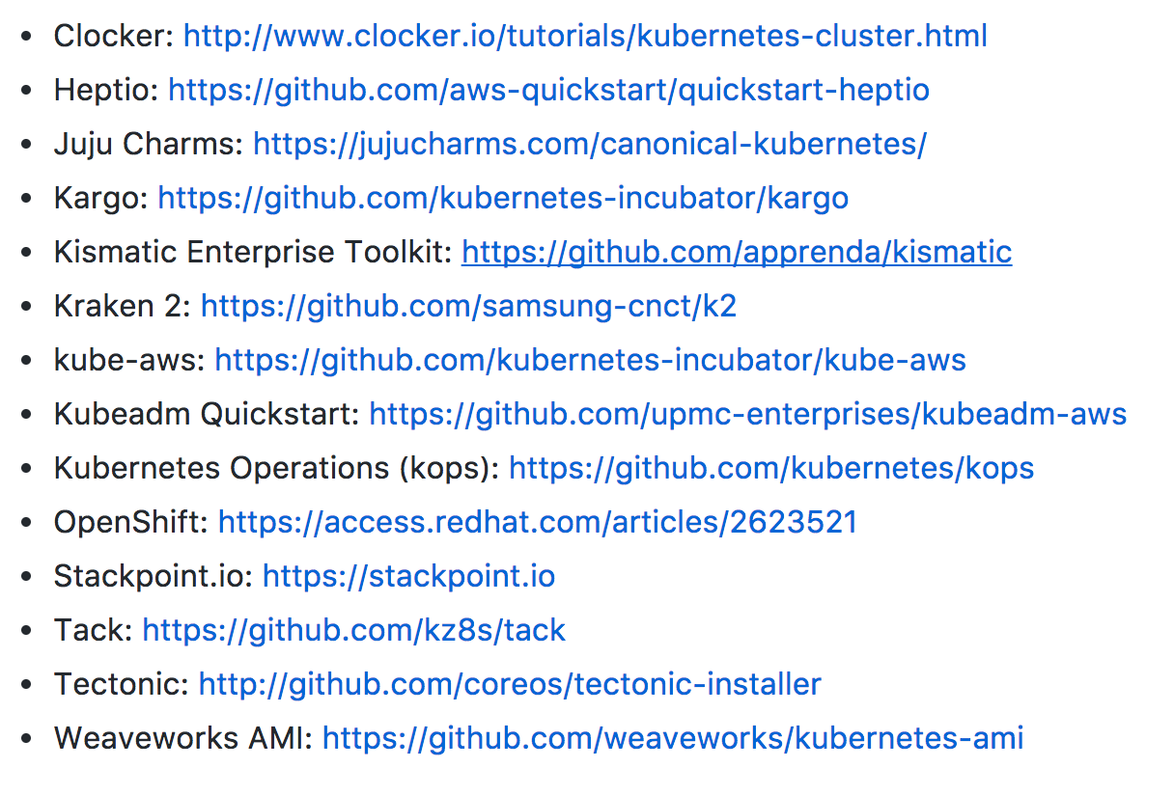
Kubernetes on AWS
https://github.com/kubernetes/community/blob/master/sig-aws/kubernetes-on-aws.md

Slide 13
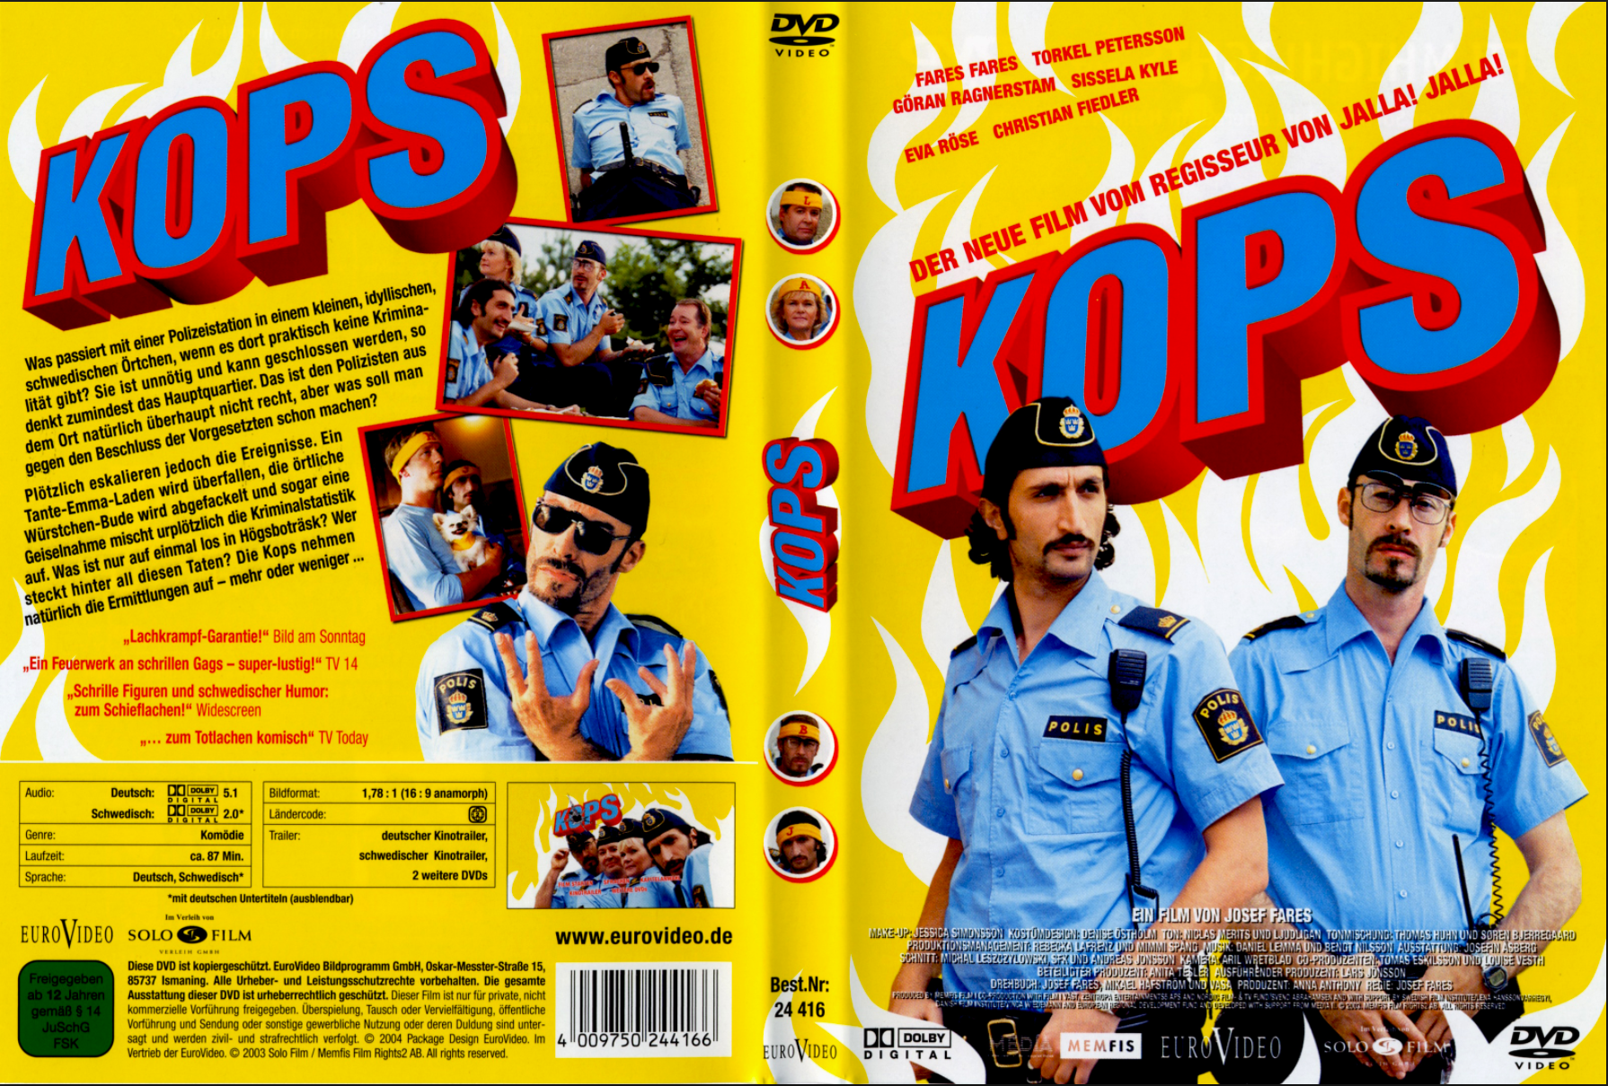
http://blog.couchbase.com/2016/november/multimaster-kubernetes-cluster-amazon-kops

Slide 14
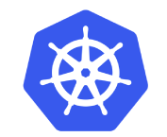
Start Kubernetes Cluster

Slide 15
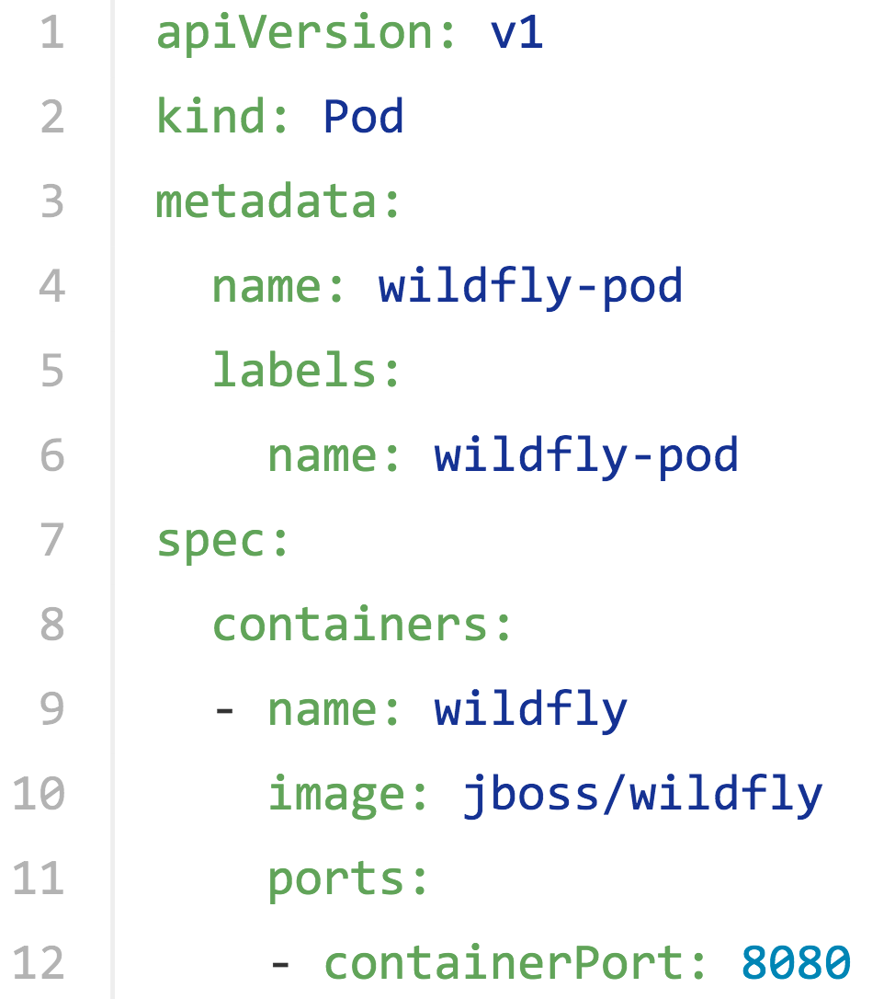
Kubernetes Pod Configuration

Slide 16
Replication Controller
Ensures that a specified number of pod "replicas" are running
Pod templates are cookie cutters
Rescheduling
Manual or auto-scale replicas
Rolling updates
Generally wrap a pod in a RC
Only appropriate for pods with Restart=Always policy (default)

Slide 17
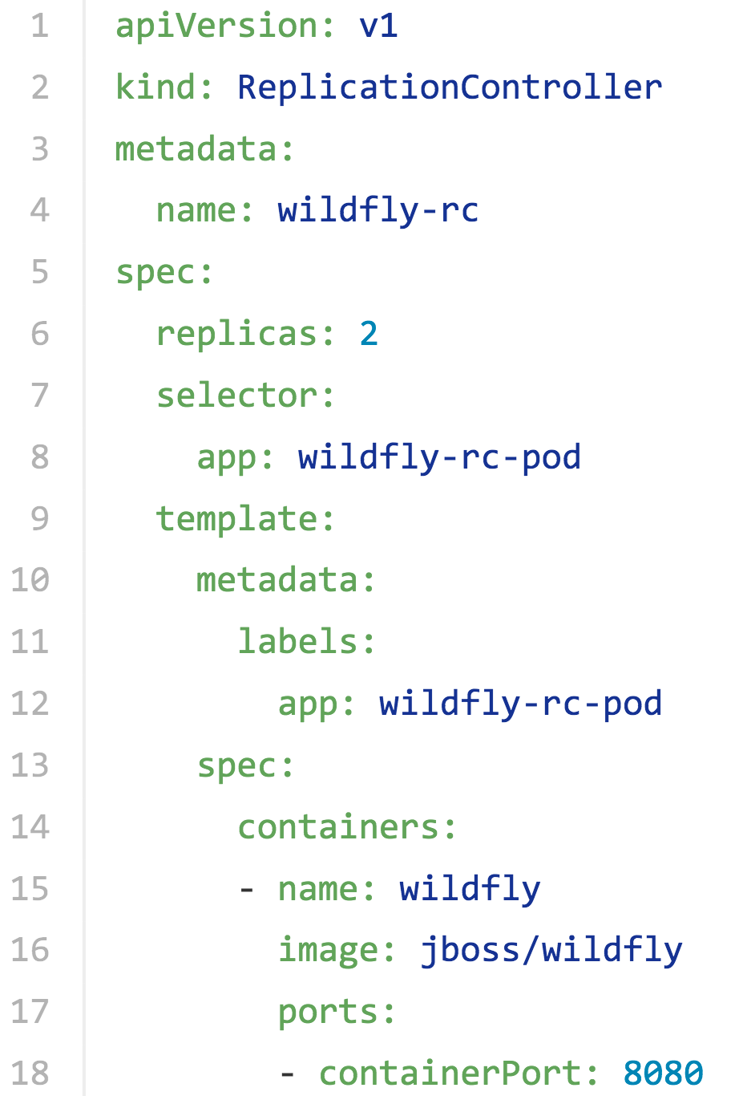
Kubernetes Replication Controller Configuration

Slide 18
Replication Controller
Master
Worker 1
Replication Controller
Worker 2
Worker 3

Slide 19

RC: “Actual” vs “Desired” State
Worker 1
Worker 1
Worker 1
Worker 1
Worker 1
Worker 2
Worker 2
✘
Worker 2
Worker 2
Worker 2
OR
OR
Worker 3
Worker 3
Worker 3
Worker 3
Worker 3

Slide 20
RC: Scale Pods
Worker 1
Worker 1
Worker 1
Worker 1
kubectl.sh scale --replicas=3 rc wildfly-rc
Worker 2
Worker 2
Worker 2
Worker 2
OR
OR
Worker 3
Worker 3
Worker 3
Worker 3

Slide 21

Kubernetes Scheduling Algorithm
Filter All Nodes
Rank Nodes
Pick A Node
1
2
3
Find nodes that meet the requirements of the pod
Spread pods across nodes and zones, favors least loaded node
Pick highest ranking node, random if multiple
Notes:
The scheduler tries to find a node for each Pod, one at a time, as it notices these Pods via watch. There are three steps. First it applies a set of "predicates" that filter out inappropriate nodes. For example, if the PodSpec specifies resource requests, then the scheduler will filter out nodes that don't have at least that much resources available (computed as the capacity of the node minus the sum of the resource requests of the containers that are already running on the node). Second, it applies a set of "priority functions" that rank the nodes that weren't filtered out by the predicate check. For example, it tries to spread Pods across nodes and zones while at the same time favoring the least-loaded nodes (where "load" here is sum of the resource requests of the containers running on the node, divided by the node's capacity). Finally, the node with the highest priority is chosen (or, if there are multiple such nodes, then one of them is chosen at random).
https://github.com/kubernetes/kubernetes/blob/master/docs/devel/scheduler.md

Slide 22
Replica Set
Next generation Replication Controller
Set-based selector requirement
Expression: key, operator, value
Operators: In, NotIn, Exists, DoesNotExist
Generally created with Deployment
Enables Horizontal Pod Autoscaling

Slide 23
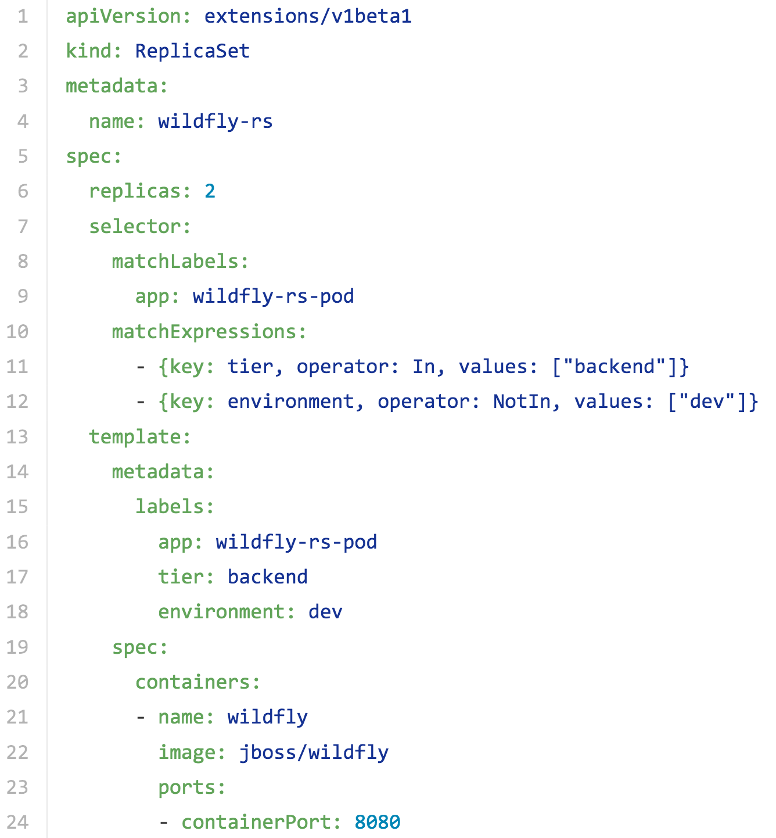
Replica Set Configuration

Slide 24
Services
Abstract a set of pods as a single IP and port
Simple TCP/UDP load balancing
Found using env variables and DNS
{SVCNAME}_SERVICE_HOST and {SVCNAME}_SERVICE_PORT
With selector: Stable endpoint for pods to reference
Allows list of pods to change dynamically
Load balance at layer 4
Does not terminate HTTPS
Without selector: Services outside cluster

Slide 25
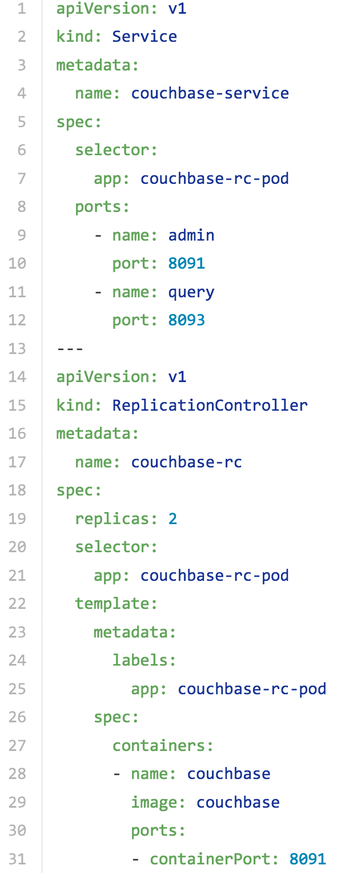
Kubernetes Service Configuration

Slide 26

Couchbase Service
Node
Couchbase Service

Slide 27
Service and Replication Controller
“frontend”
“backend”
Couchbase Service

Slide 28
Publishing Services
Service may be exposed outside cluster using type
ClusterIP (default): Accessible inside cluster
NodePort: A port on each node, explicitly expose in firewall
LoadBalancer: On cloud providers that support external LB
ExternalName: CNAME record value for an external service

Slide 29
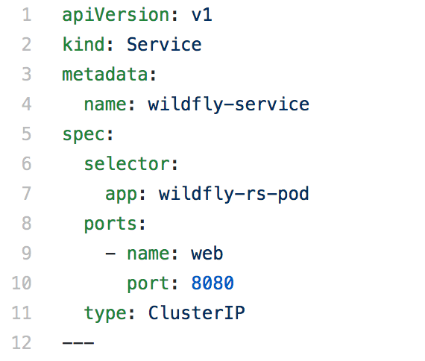
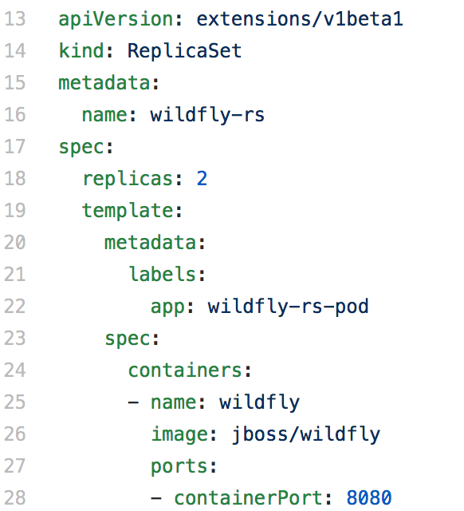
Service Type: ClusterIP

Slide 30
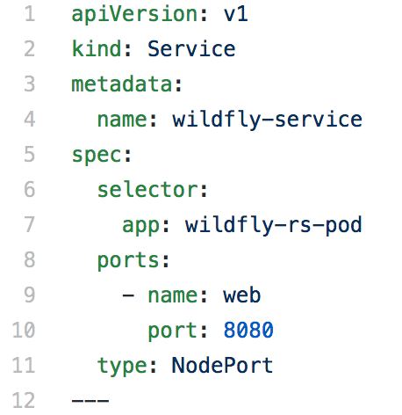
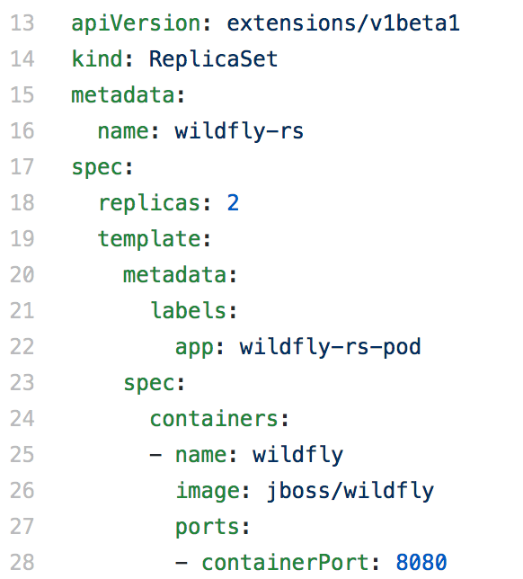
Service Type: NodePort

Slide 31
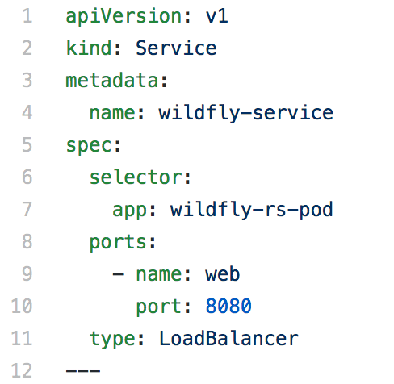
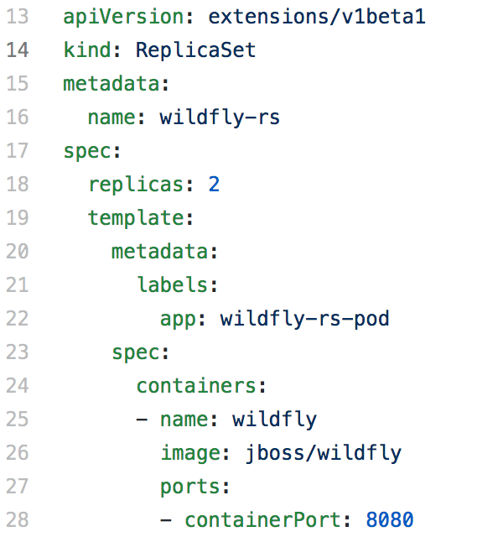
Service Type: Load Balancer

Slide 32
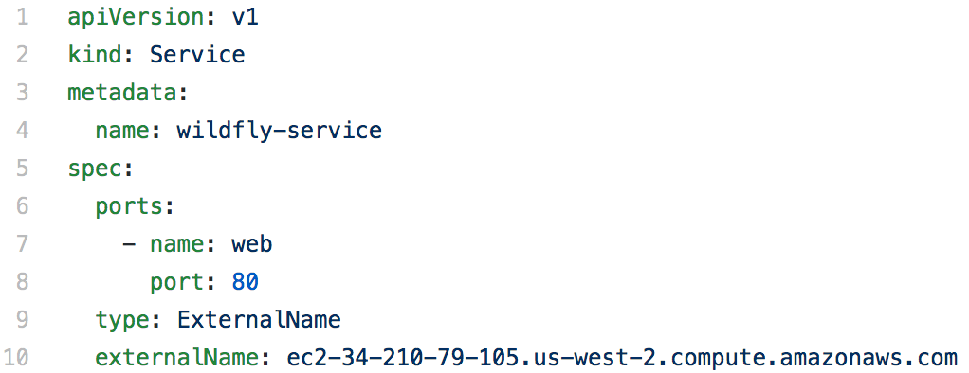
Service Type: ExternalName

Slide 33

Publish Service on AWS
Deployment
Publicly
accessible
Service
Docker
Container
Pod
Amazon Web Services
“master”
“worker”
“worker”
Kubernetes Cluster

Slide 34
Ingress Load Balancer
Service can be exposed using LoadBalancer
Expensive for multiple services
Ingress combines multiple services in a single entry point
Resource: Rules and configuration for how traffic is routed to services
Controller: Listens to API server, creates resources, route traffic to services
Benefits
Load balance at layer 7
Routing based on metadata (hosts or paths)
TLS termination, …

Slide 35
Deployment
Declarative updates for pods and replica sets
For example: rolling updates
Differences from kubectl
Declarative instead of imperative
Server-side, and so is faster
More features, e.g. rollback to previous version

Slide 36
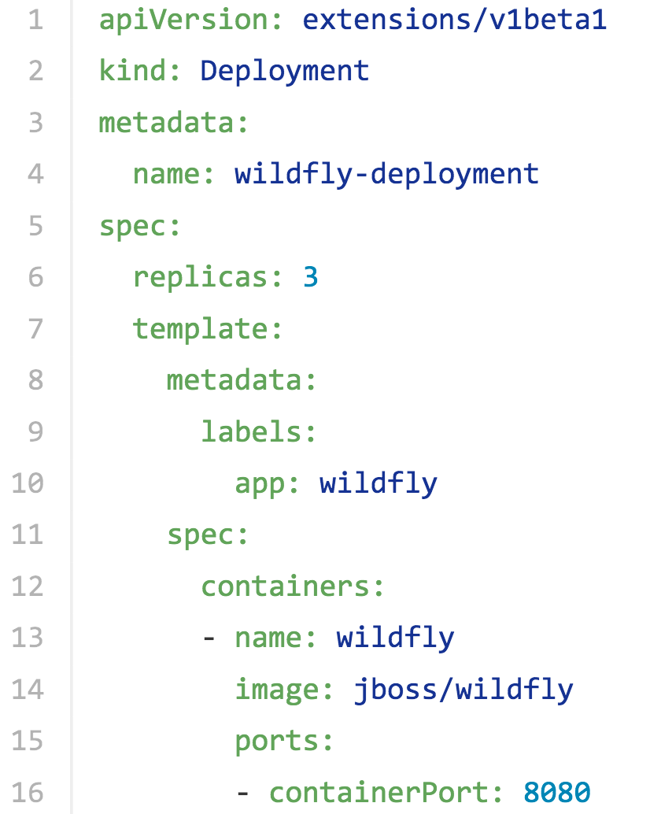
Deployment Configuration

Slide 37
Operator
Application-specific controller that extends Kubernetes API to create, configure, and manage instances of complex stateful applications
Uses resource and controller concepts
For example: ReplicaSet set, in-built Controller
Includes domain or application-specific knowledge to automate common tasks
For example, etcd operator:
Create a DNS name for the new member
Launch the new instance
etcdctl member add

Slide 38
CRUD Kubernetes Resources

Slide 39


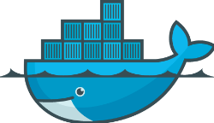
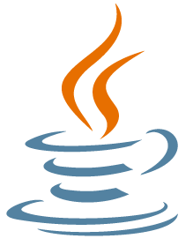
Kubernetes and Java Developers
Create Docker Image
Build Archive
Push to Docker Hub
Create Kubernetes Resource Description
CRUD Kubernetes Resources
Start Kubernetes Cluster

Slide 40
Rolling Updates
Application Service
1
2
1
2
1
2
1
2
1
2

Slide 41
Rolling Updates - Replication Controller
kubectl rolling-update webapp-rc -f webapp-rc2.json
kubectl rolling-update webapp-rc --image=arungupta/wildfly-app:2
Created webapp-rc-5a11f15230716f6026c407eb9c1a60ca
Scaling up webapp-rc-5a11f15230716f6026c407eb9c1a60ca from 0 to 2, scaling down webapp-rc from 2 to 0 (keep 2 pods available, don't exceed 3 pods)
Scaling webapp-rc-5a11f15230716f6026c407eb9c1a60ca up to 1
Scaling webapp-rc down to 1
Scaling webapp-rc-5a11f15230716f6026c407eb9c1a60ca up to 2
Scaling webapp-rc down to 0
Update succeeded. Deleting old controller: webapp-rc
Renaming webapp-rc-5a11f15230716f6026c407eb9c1a60ca to webapp-rc
replicationcontroller "webapp-rc" rolling updated
https://github.com/arun-gupta/kubernetes-java-sample/tree/master/rolling-update

Slide 42
Rolling Updates
webapp-rc
1
1
1
Application Service
webapp-rc-xxxx
webapp-rc
etcd
2
2
2
https://github.com/arun-gupta/kubernetes-java-sample/tree/master/rolling-update

Slide 43

Horizontal Pod Autoscaling
. . .
Replication Controller / Replica Set / Deployment
scale
Horizontal Pod Autoscaler
Based on observed CPU utilization
Application provided metrics (health)

Slide 44
Horizontal Pod Autoscaling
Typical usage
kubectl autoscale deployment | rc | rs --min=<PODS> --max=<PODS> —cpu-percent=<CPU>
Autoscale a deployment with number of pods between 2 and 10
kubectl autoscale deployment db --min=2 --max=10
Autoscale a Replication with maximum number of pods 5, target CPU utilization of 80%
kubectl autoscale rc --max=5 --cpu-percent=80

Slide 45
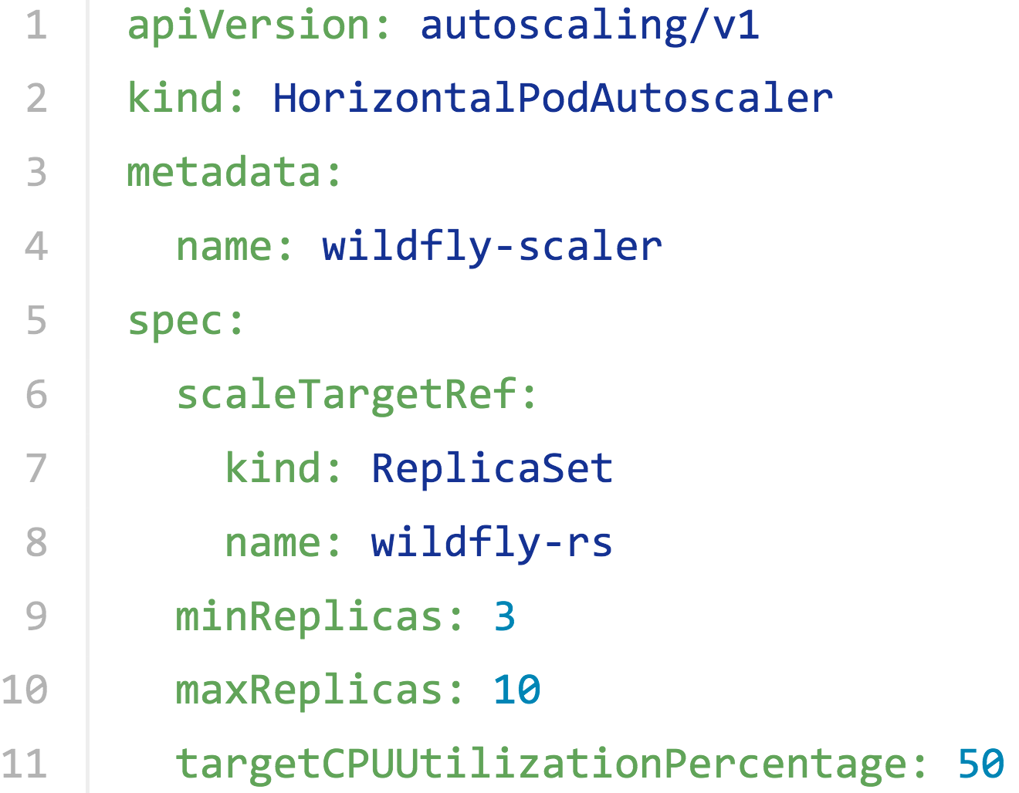
HPA Configuration

Slide 46
Volumes
Directory accessible to the containers in a pod
Volume outlives any containers in a pod
Common types
hostPath
nfs
awsElasticBlockStore
gcePersistentDisk
Notes:
A Kubernetes Volume outlives any containers that run within the pod, and data is preserved across container restarts. However the volume will cease to exist when a pod ceases to exist.

Slide 47
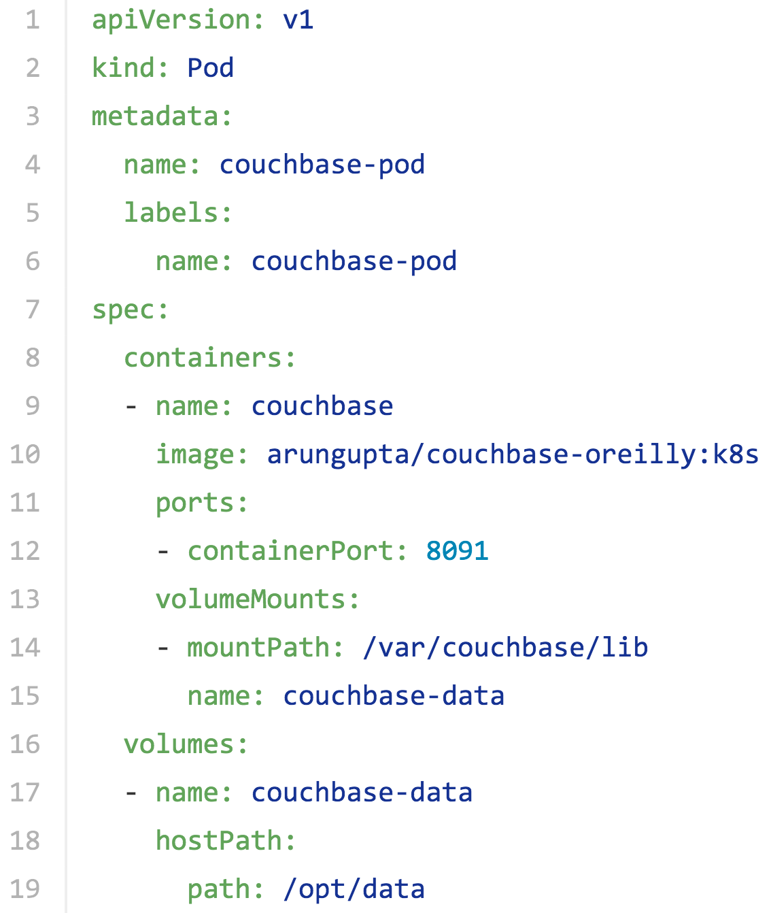
Volume Configuration

Slide 48

Stateful Containers
Replication Controller
Couchbase
Docker
Container
Publicly
accessible
Service
Pod
Amazon Web Services
“master”
“worker”
“worker”
Kubernetes Cluster
Storage

Slide 49
Stateful Containers
Amazon Web Services
“master”
“worker”
“worker”
EBS
http://blog.couchbase.com/2016/july/stateful-containers-kubernetes-amazon-ebs

Slide 50
Stateful Containers
Amazon Web Services
“master”
“worker”
“worker”
EBS

Slide 51
Persistent Volume
Provision Network Storage
Request Storage
Use Claim
1
2
3
PersistentVolume
PersistentVolumeClaim
Claims are mounted as volumes
http://blog.couchbase.com/2016/july/stateful-containers-kubernetes-amazon-ebs
Notes:
Provision: Administrator provision a networked storage in the cluster, such as AWS ElasticBlockStore volumes. This is called as PersistentVolume.
Request storage: User requests storage for pods by using claims. Claims can specify levels of resources (CPU and memory), specific sizes and access modes (e.g. can be mounted once read/write or many times write only). This is called as PersistentVolumeClaim.
Use claim: Claims are mounted as volumes and used in pods for storage.

Slide 52
Couchbase Cluster on Kubernetes
Couchbase
Image
replicas=1
replicas=3
“Master”
Replication
Controller
“Worker”
Replication
Controller
Couchbase
Cluster
https://github.com/arun-gupta/couchbase-kubernetes/tree/master/cluster
http://blog.kubernetes.io/2016/08/create-couchbase-cluster-using-kubernetes.html

Slide 53
Stateful Set
PetSet introduced as Alpha resource in 1.3
Renamed to StatefulSet in 1.5, upgraded to Beta
Stateful pods
StatefulSet has 0..N-1 Pods
Each Pod has a deterministic name, and a unique identity
stable hostname
ordinal index
stable storage linked to ordinal & hostname
Each StatefulSet has at most one Pod with a given identity
couchbase-0
couchbase-1
couchbase-2
. . .
couchbase-N-1
https://github.com/arun-gupta/couchbase-kubernetes/tree/master/cluster-statefulset
Notes:
A PetSet, in contrast, is a group of stateful pods that require a stronger notion of identity.
elationship between Pets and Pods: PetSet requires there be {0..N-1} Pets. Each Pet has a deterministic name - PetSetName-Ordinal, and a unique identity. Each Pet has at most one pod, and each PetSet has at most one Pet with a given identity.

Slide 54
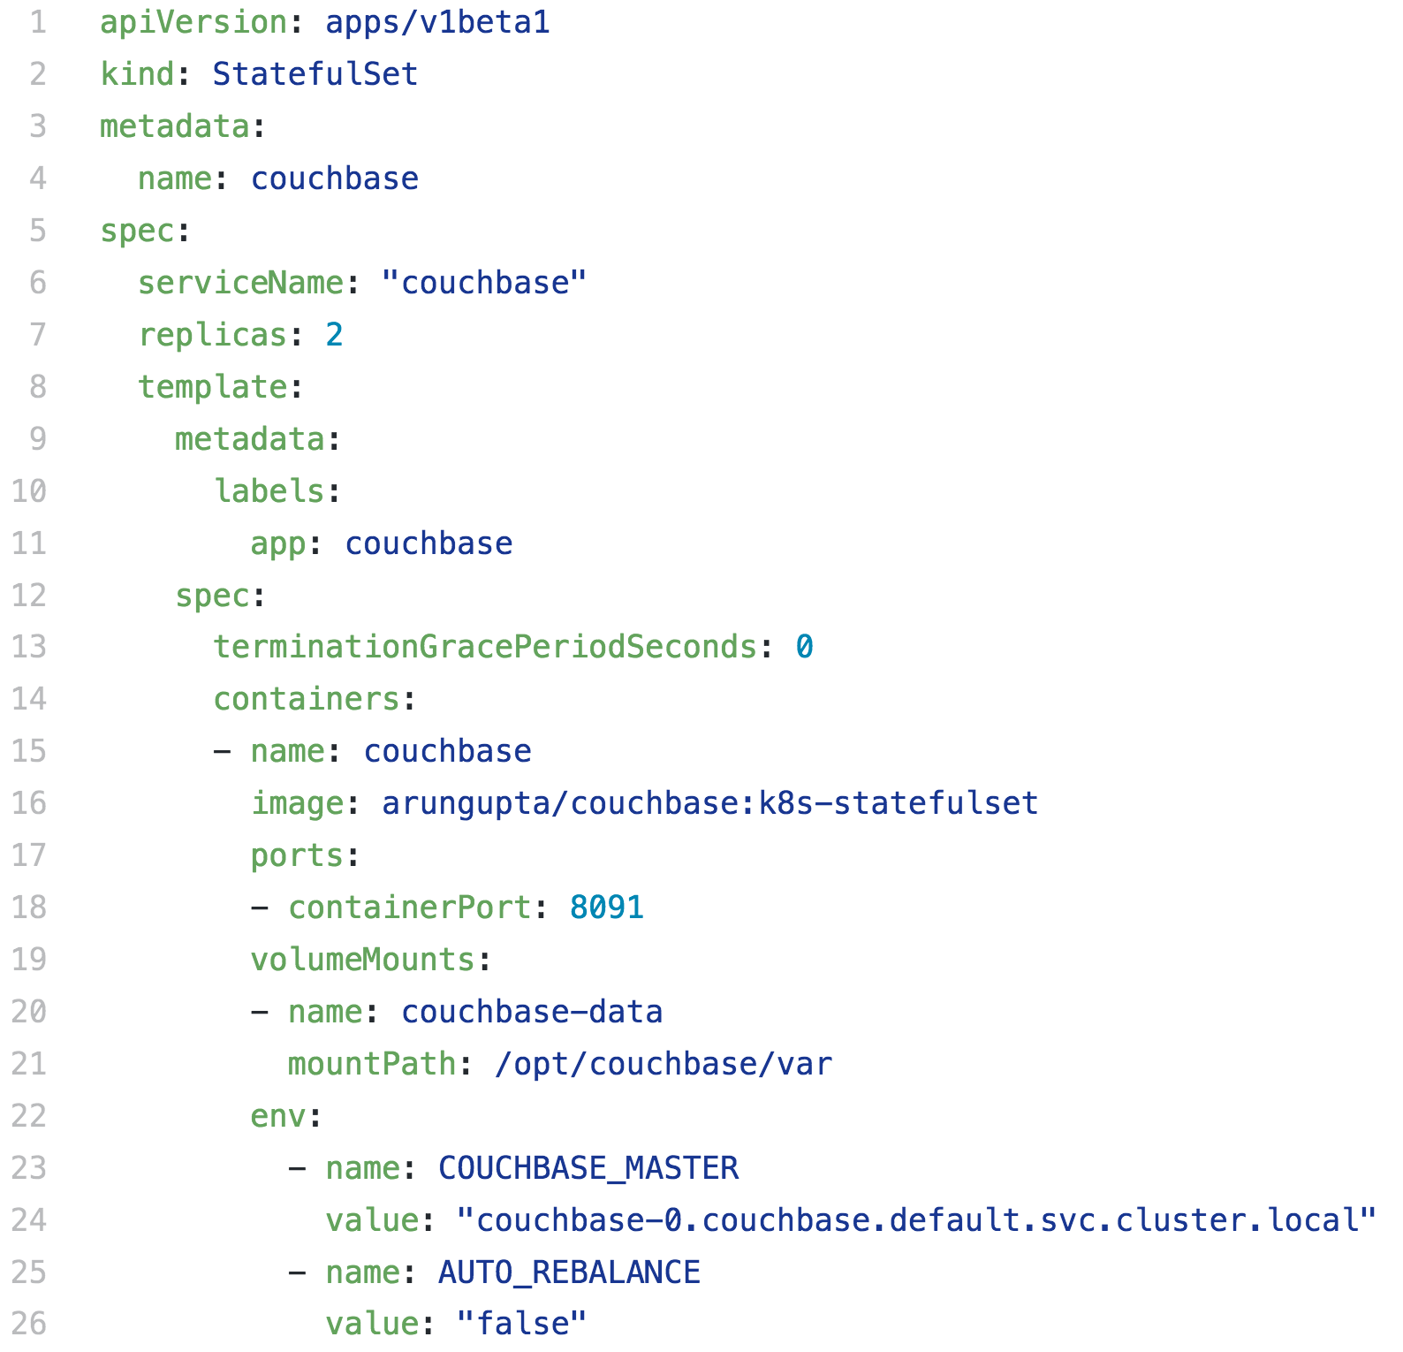
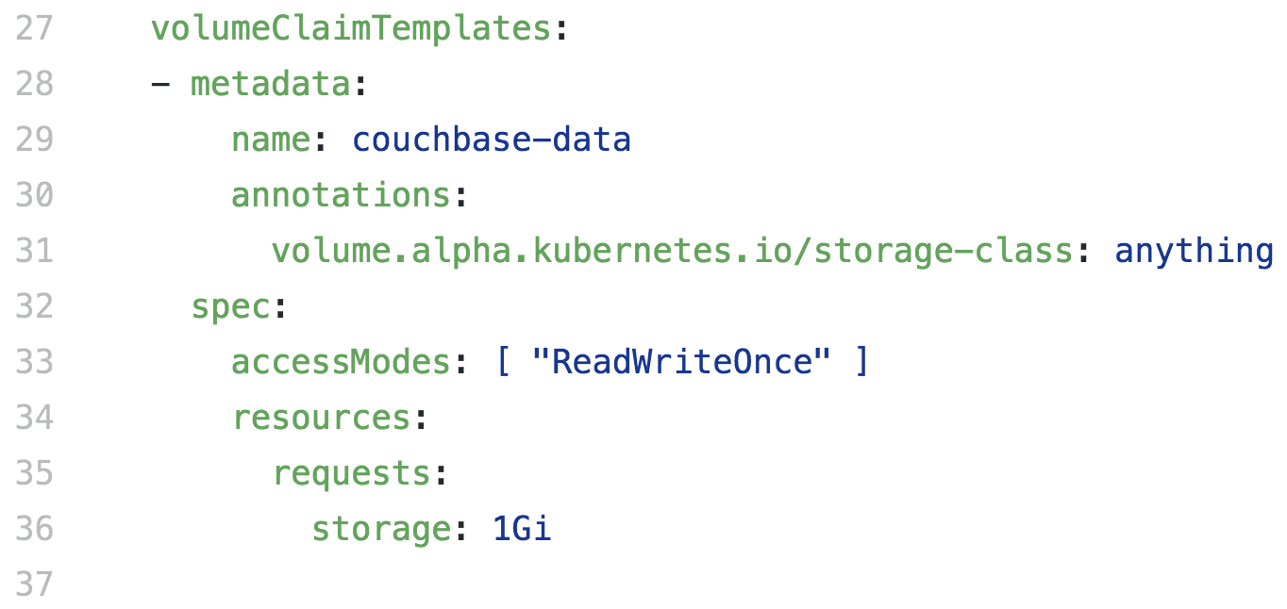

Slide 55

Portworx
Data services for containers
Deploys as a container
Automated with scheduler to pool capacity
Kubernetes, Swarm and DC/OS
Multi-cluster visibility and management
Replication and snapshots
REST API and CLI

Slide 56
Stateful Containers with Portworx
Amazon Web Services
“master”
“worker”
“worker”
SSD
SAN
EBS
HDD
S3
https://github.com/arun-gupta/couchbase-kubernetes/tree/master/cluster-petset-portworx

Slide 57
Multitenancy - Namespace
Namespace allows to partition resources into a logical group
Each namespace provides:
scope for resources to avoid collisions
policies to ensure appropriate authority to trusted users
constraints for resource consumption
Anti-pattern: Separate slightly different resources, e.g. different version
Use labels instead
Notes:
By default, all resources in Kubernetes cluster are created in a default namespace. A pod will run with unbounded CPU and memory requests/limits. A Kubernetes namespace allows to partition created resources into a logically named group.
This allows a Kubernetes cluster to share resources by multiple groups and provide different levels of QoS each group. Resources created in one namespace are hidden from other namespaces. Multiple namespaces can be created, each potentially with different constraints.

Slide 58
Multitenancy - Resource Quota
Each resource specify request and limit
Limit aggregate resource consumption per namespace
Object count quota: pods, replicationcontrollers, services, …
Compute: cpu, memory, storage, …
1 memory = Exa, Peta, Tera, Giga, Mega, Kilo
1 cpu = 1 AWS vCPU, 1 GCP Core, 1 Azure vCore, 1 Hyperthread on bare-metal
Notes:
For each resource, containers specify a request, which is the amount of that resource that the system will guarantee to the container, and a limit which is the maximum amount that the system will allow the container to use.
The system computes pod level requests and limits by summing up per-resource requests and limits across all containers. When request == limit, the resources are guaranteed, and when request < limit, the pod is guaranteed the request but can opportunistically scavenge the difference between request and limit if they are not being used by other containers. This allows Kubernetes to oversubscribe nodes, which increases utilization, while at the same time maintaining resource guarantees for the containers that need guarantees.

Slide 59
Multitenancy - Limit

Slide 60
Batch Jobs
Run-once jobs
Replication Controller, Replica Set or Deployments not suitable
Three types
Non-parallel: only one pod is started
Parallel:
With a fixed completion count
With a work queue
http://kubernetes.io/docs/user-guide/jobs/

Slide 61
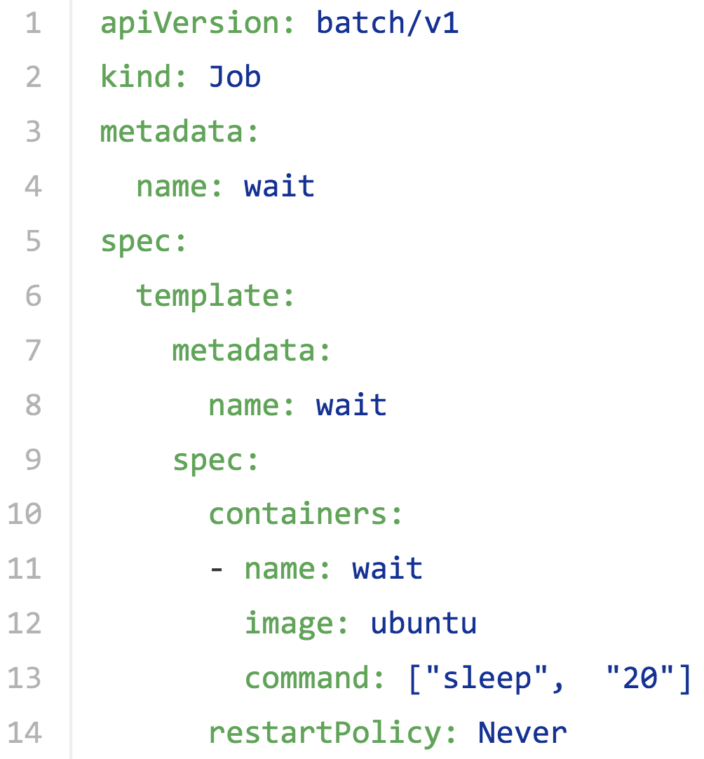
Run-Once Job Specification

Slide 62

Java Application in Kubernetes
Replication Controller
Job
Pod
Service
Pod
Couchbase Service
replicas=1
reads
writes
etcd
app: couchbase-rc-pod

Slide 63
Health Checks
Health checks performed by Kubelet
Probes - Liveness and Readiness
Diagnostics
Container Exec
TCP Socket
HTTP

Slide 64
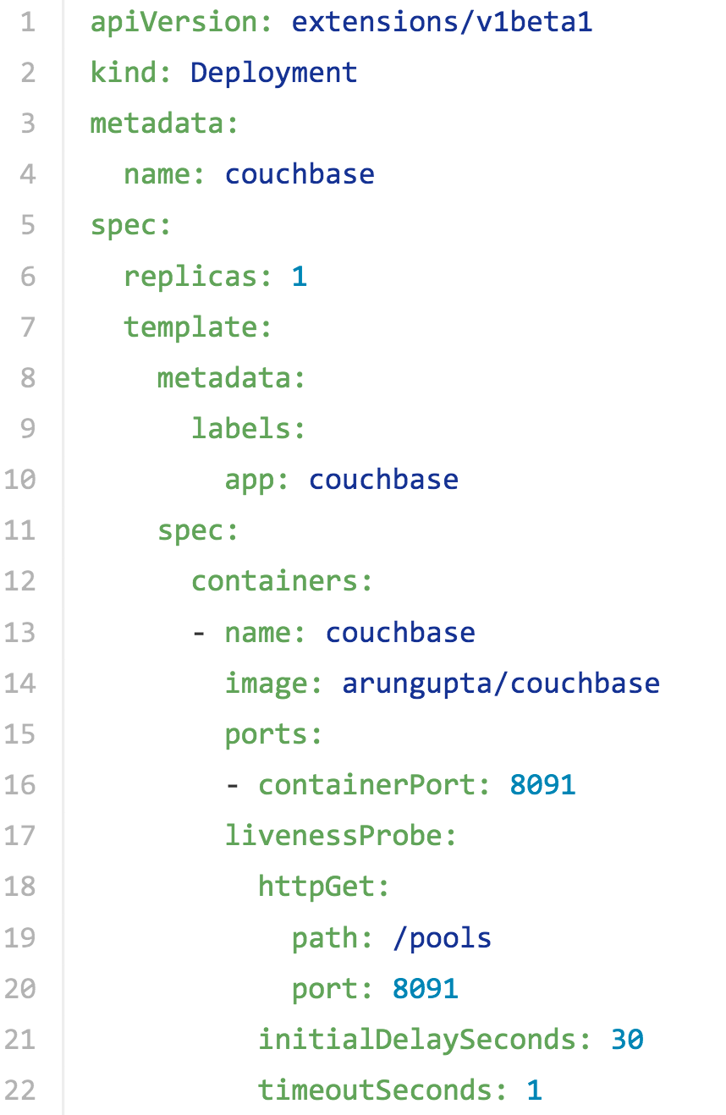

Slide 65
Monitoring Kubernetes Resources
Master
Worker
Worker
Worker
Kubelet
cAdvisor
Kubelet
cAdvisor
Kubelet
cAdvisor
InfluxDB + Grafana
Heapster

Slide 66
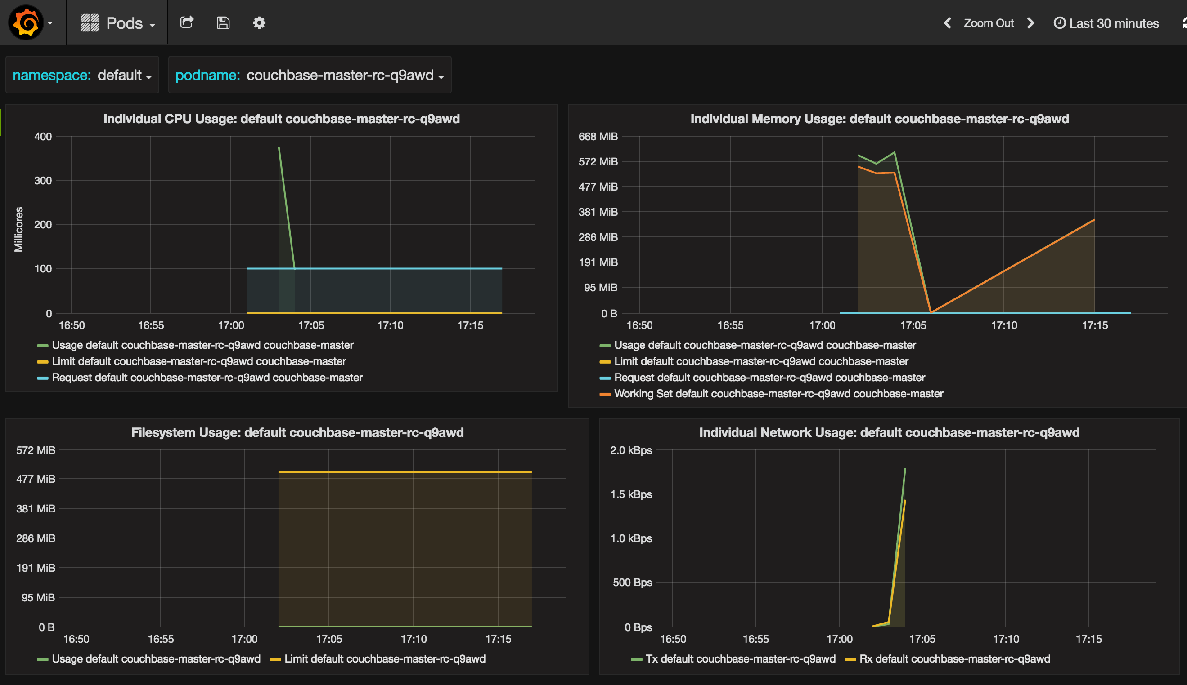
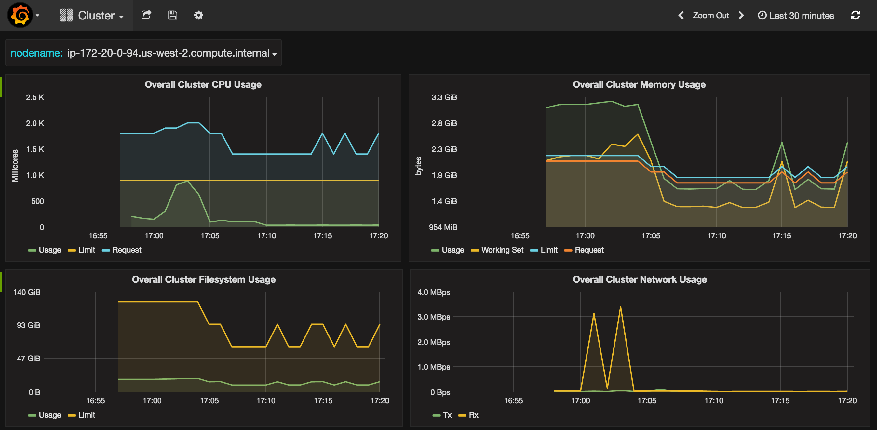
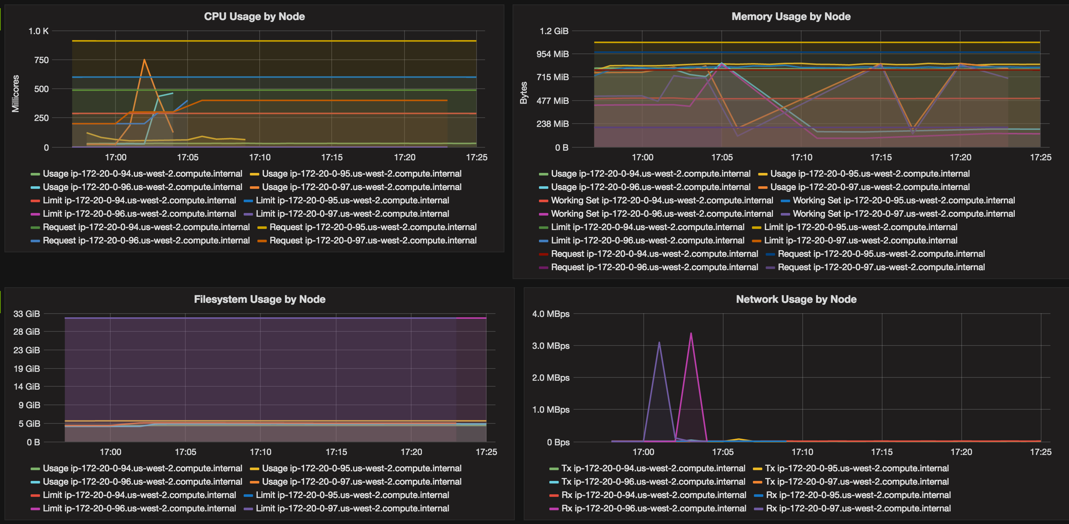

Slide 67


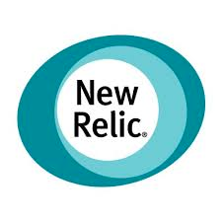

Kubernetes Monitoring

Slide 68


Sample Production Deployment
www.wombatsoftware.de
shopadvisors.de: E-commerce optimization and monitoring tools for increase of sales

Slide 69

Sample Production Deployment
32 Core
160 GB RAM
Load | Containers
Normal | 400
Peak | 600

Slide 70
Kubernetes and Maven
fabric8-maven-plugin
Brings your Java applications to Kubernetes and OpenShift
Build Docker images
Creates Kubernetes and OpenShift resource descriptors
Opinionated defaults, XML configuration as well
Reference: github.com/fabric8io/fabric8-maven-plugin
https://github.com/arun-gupta/kubernetes-java-sample/tree/master/maven

Slide 71
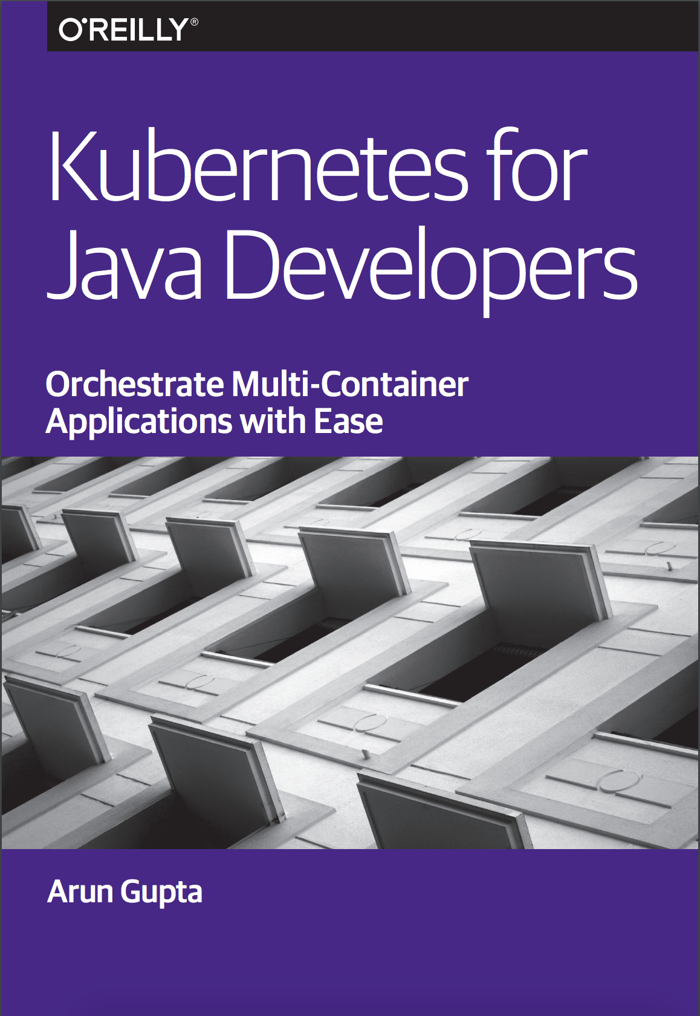

Slide 72
References
kubernetes.io
github.com/arun-gupta/kubernetes-java-sample

